Slide 1
Automating goal-based adaptive mesh refinement for engineering problems
Joe Flood

Slide 2
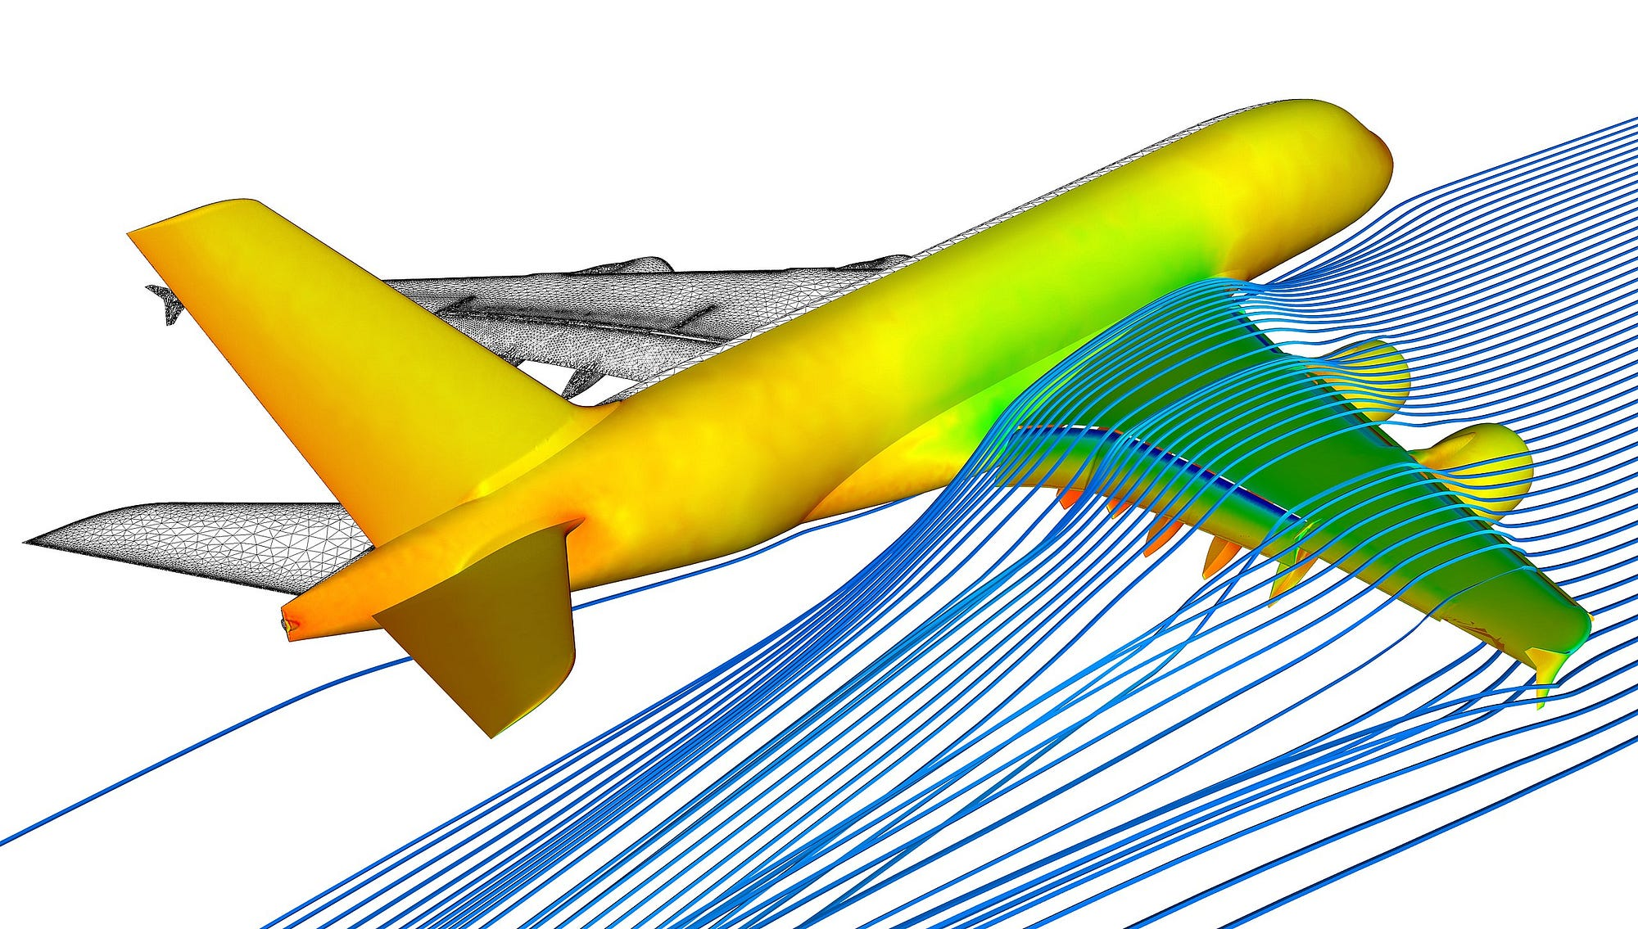
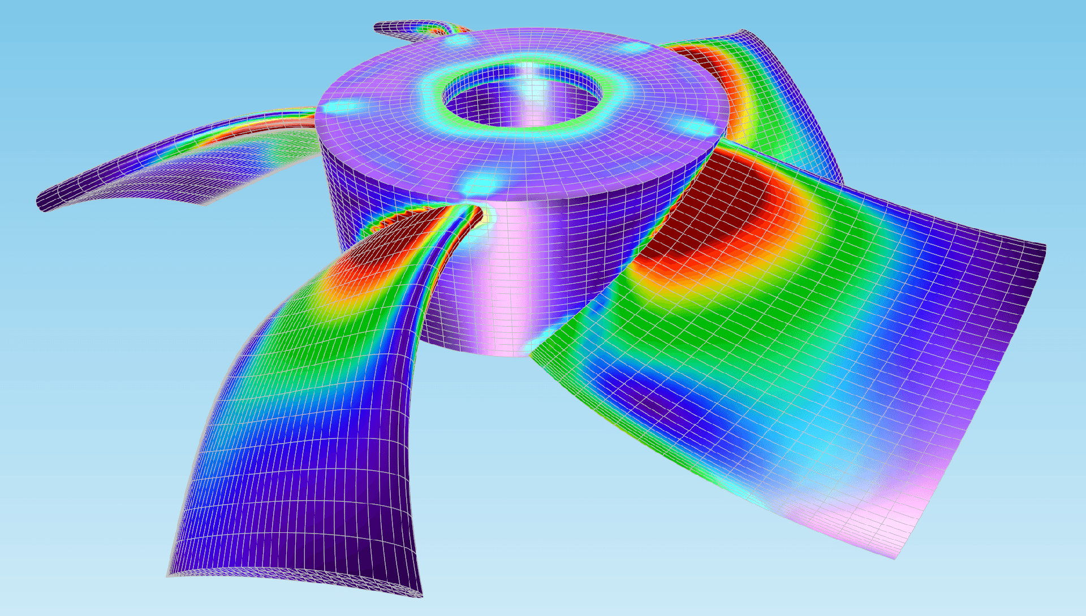
Motivation: Engineering simulation
Engineers care about Quantities of Interest (QoIs) – not the entire solution field
Understanding the error in QoIs is important
Lift, drag
Avg. stress on surface

Slide 3
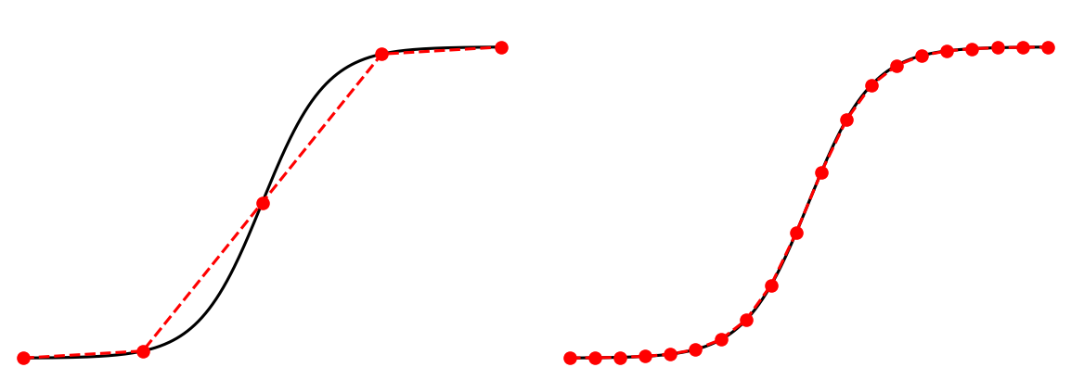







Background: Finite element methods
Variational formulation
Finite element formulation
Linear algebra problem
Accuracy depends on the mesh size ($h$):
PDE
Solution
$$ℒu=f$$
$$a(u,v)=\left\langle f,v\right\rangle$$
$$a(u_{h},v_{h})=\left\langle f,v_{h}\right\rangle$$
$$Au_{h}=f_{h}$$
$$u_{h}$$
Weaken differentiability
requirements
Approximate on finite-dimensional function space
Quadrature (assembly)
Solve
$${\left\langle a,b\right\rangle }_{k} :=\int_{k}{ab dx}$$

Slide 4
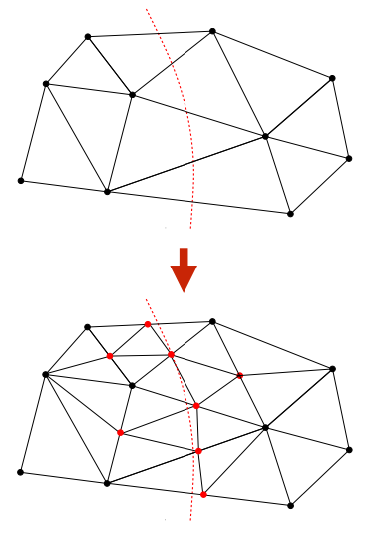

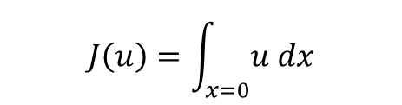
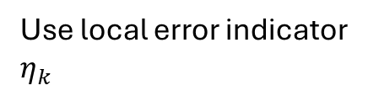
Solution: Goal-based adaptive meshing
$$J\left(u\right)=\int_{x=0}{u dx}$$
QoI
Define goal functional
Aim 1: Estimate error
Aim 2: Control error
How to control? Adapt mesh!
$$η_{h}≔\left|J\left(u\right)−J(u_{h})\right|≤tolerance$$
Use local error indicator $η_{k}$

Slide 5



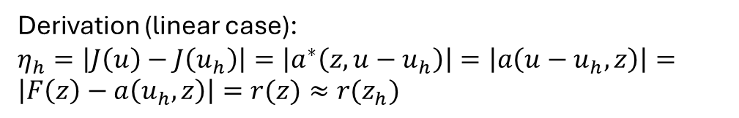


How to estimate $η_{h}$? (Global error estimate)
(Weak) problem:
$a\left(u_{h},v_{h} \right)=F\left(v_{h}\right)$, for all $v_{h}∈V_{h}$
$$u_{h}$$
Residual:
Dual problem:
Global error:
$r\left(v_{h}\right) :=F\left(v_{h}\right)−a(u_{h},v_{h})$, for any $v_{h}∈V_{h}$
$a^{∗}\left(z_{h},v\right)=J\left(v\right)$, for all $v_{h}∈V_{h}$
$$z_{h}$$
$$η_{h}=\left|r(z_{h})\right|=\left|F\left(z_{h}\right)−a\left(u_{h},z_{h}\right)\right|$$
(From theorem [1])
Derivation (linear case):
$η_{h}=\left|J\left(u\right)−J\left(u_{h}\right)\right|=\left|a^{∗}\left(z,u−u_{h}\right)\right|=\left|a\left(u−u_{h},z\right)\right|=\left|F\left(z\right)−a\left(u_{h},z\right)\right|=r(z)≈r(z_{h})$
Notes:
1. An optimal control approach to a posteriori error control. R. Rannacher

Slide 6

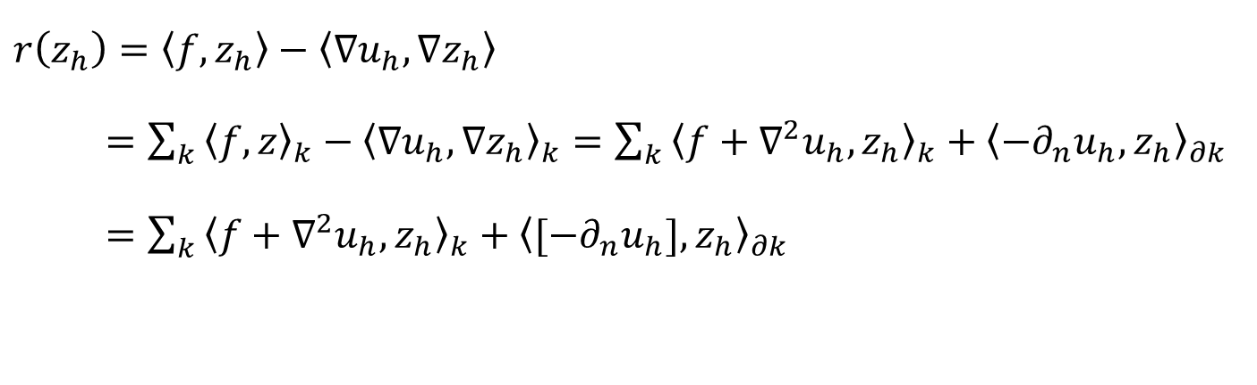
How to obtain $η_{k}$? (Local error indicator)
Example: Poisson equation
$r\left(z_{h}\right)=\left\langle f,z_{h}\right\rangle −\left\langle ∇u_{h},∇z_{h}\right\rangle$
$=\sum_{k}{{\left\langle f,z\right\rangle }_{k}−{\left\langle ∇u_{h},∇z_{h}\right\rangle }_{k}}=\sum_{k}{{\left\langle f+∇^{2}u_{h},z_{h}\right\rangle }_{k}+{\left\langle −∂_{n}u_{h},z_{h}\right\rangle }_{∂k}}$
$=\sum_{k}{{\left\langle f+∇^{2}u_{h},z_{h}\right\rangle }_{k}+{\left\langle [−∂_{n}u_{h}],z_{h}\right\rangle }_{∂k}}$
$$η_{k}=\left|{\left\langle f+∇^{2}u_{h},z_{h}\right\rangle }_{k}+{\left\langle [−∂_{n}u_{h}],z_{h}\right\rangle }_{∂k}\right|$$
Previously: Had to be derived manually for each problem
Notes:
Talk about how this has to be done manually for each problem

Slide 7
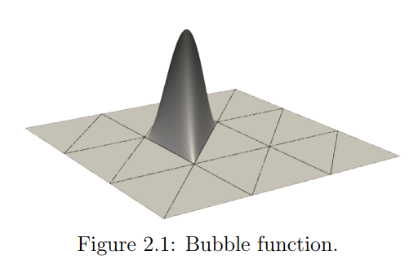
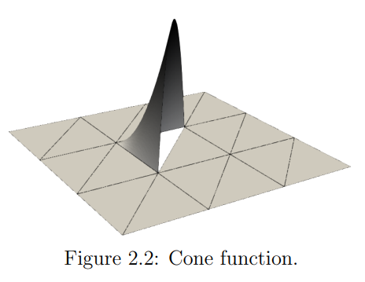
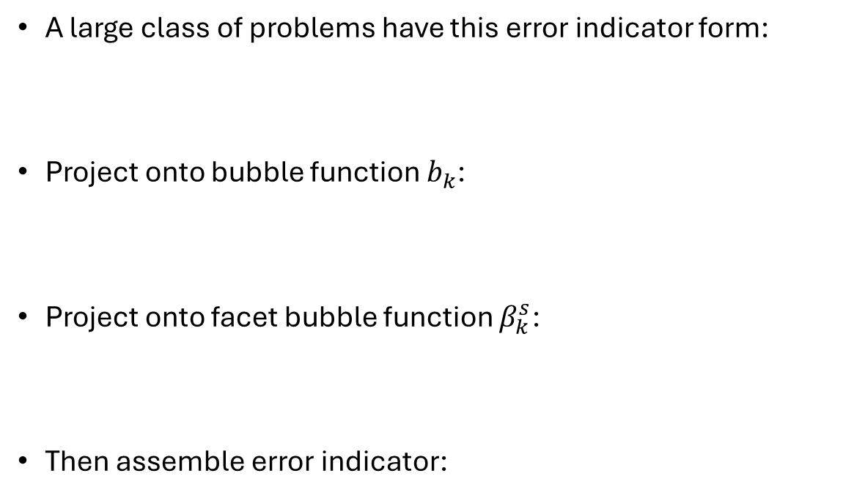
Automated local error indicators
A large class of problems have this error indicator form:
Project onto bubble function $b_{k}$:
Project onto facet bubble function $β_{k}^{s}$:
Then assemble error indicator:
$$η_{k}=\left|{\left\langle R_{k}\left(u_{h}\right),z_{h}\right\rangle }_{k}+{\left\langle {[R}_{∂k}(u_{h})],z_{h}\right\rangle }_{∂k}\right|$$
$${\left\langle R_{k}, b_{k}\right\rangle }_{k}=r(b_{k})$$
$${\left\langle R_{∂k}, β_{k}^{s}\right\rangle }_{s}=r\left(β_{k}^{s}\right)−{\left\langle R_{k}, β_{k}^{s}\right\rangle }_{k}$$
$$η_{k}=\left|{\left\langle R_{k},z\right\rangle }_{k}+{\left\langle {[R}_{∂k}],z\right\rangle }_{∂k}\right|$$

Slide 8
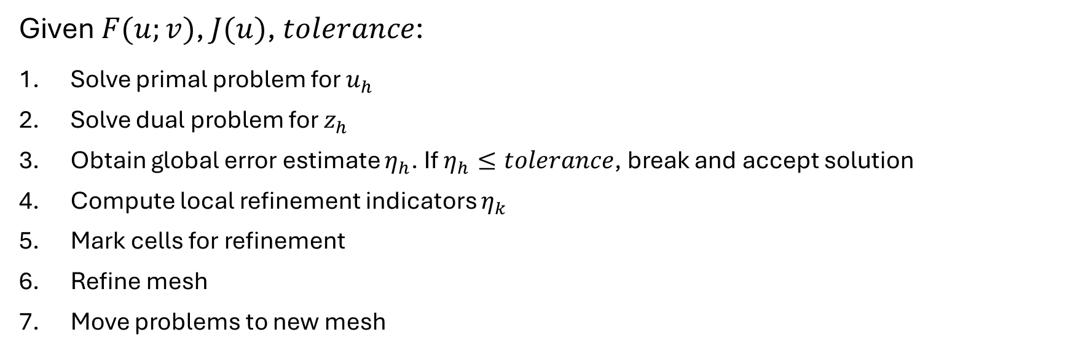
Automated algorithm
Given $F(u;v)$, $J(u)$, $tolerance$:
Solve primal problem for $u_{h}$
Solve dual problem for $z_{h}$
Obtain global error estimate $η_{h}$. If $η_{h}≤tolerance$, break and accept solution
Compute local refinement indicators $η_{k}$
Mark cells for refinement
Refine mesh
Move problems to new mesh
Solve primal
Solve dual
Global error
Local errors
Mark
Refine

Slide 9
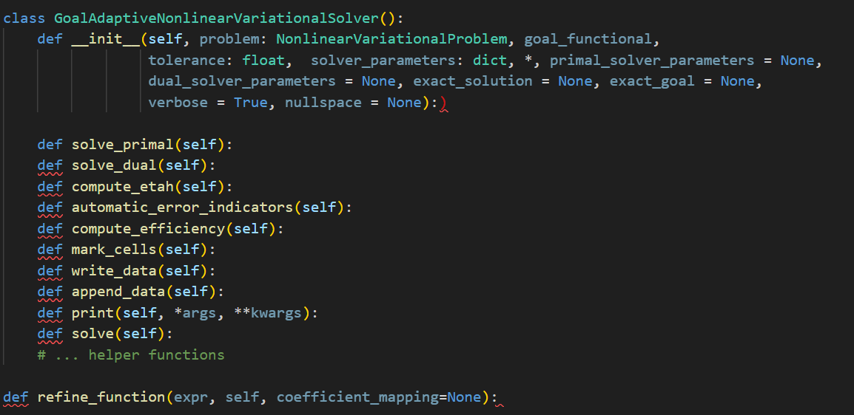
Implementation (Firedrake)

Slide 10
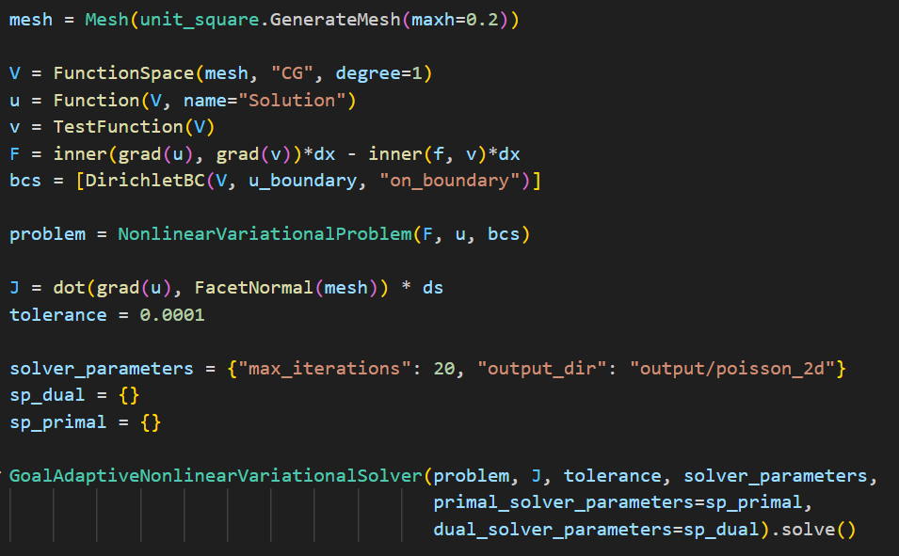
User input

Slide 11
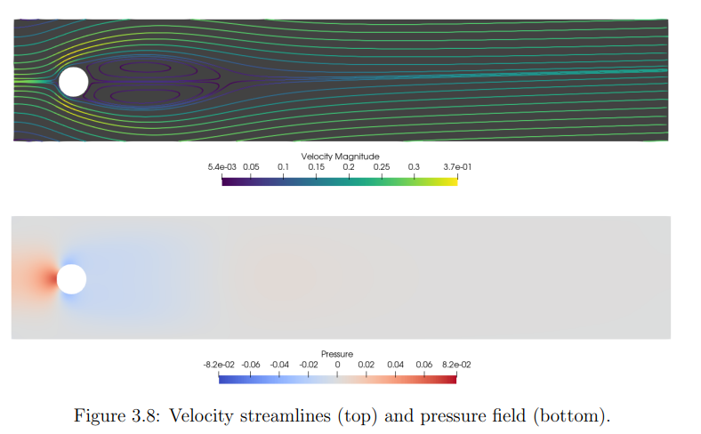

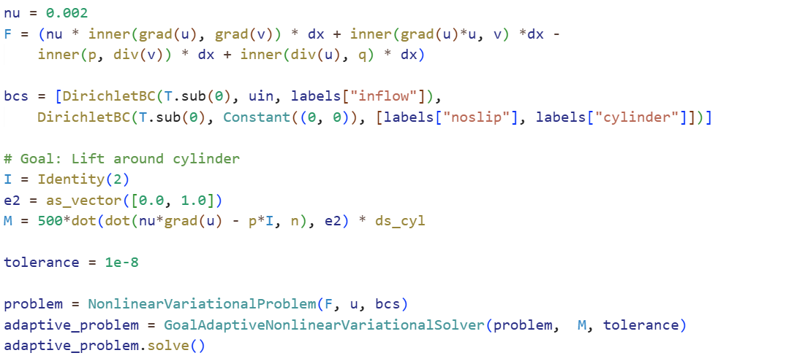
Example: Lift generated by cylinder
Problem:
User input:

Slide 12
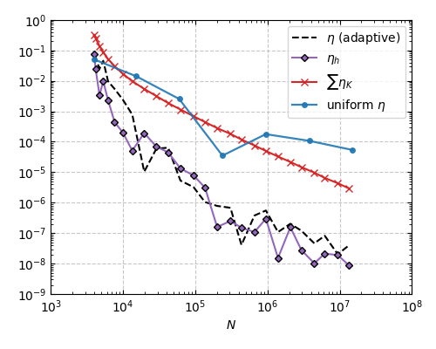
Example: Lift generated by cylinder
Error
Number of degrees of freedom

Slide 13
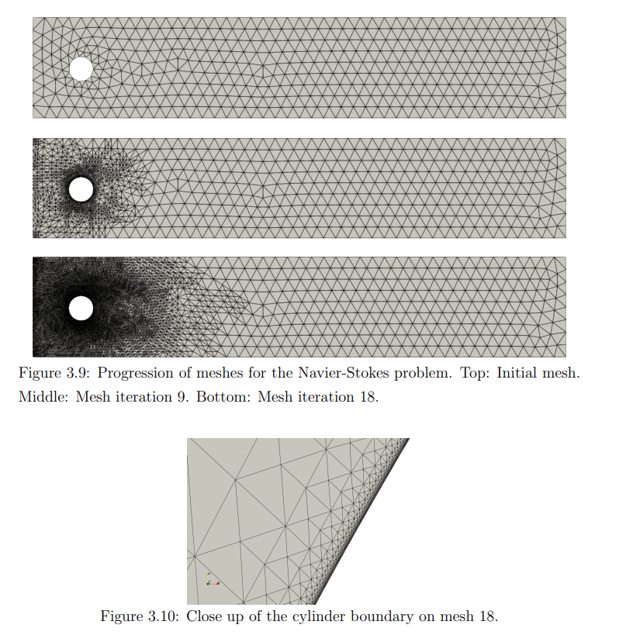
Example: Lift generated by cylinder

Slide 14

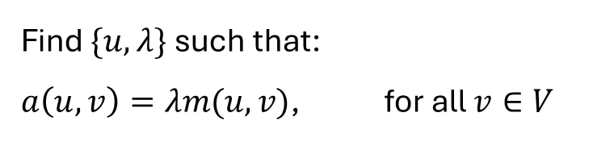
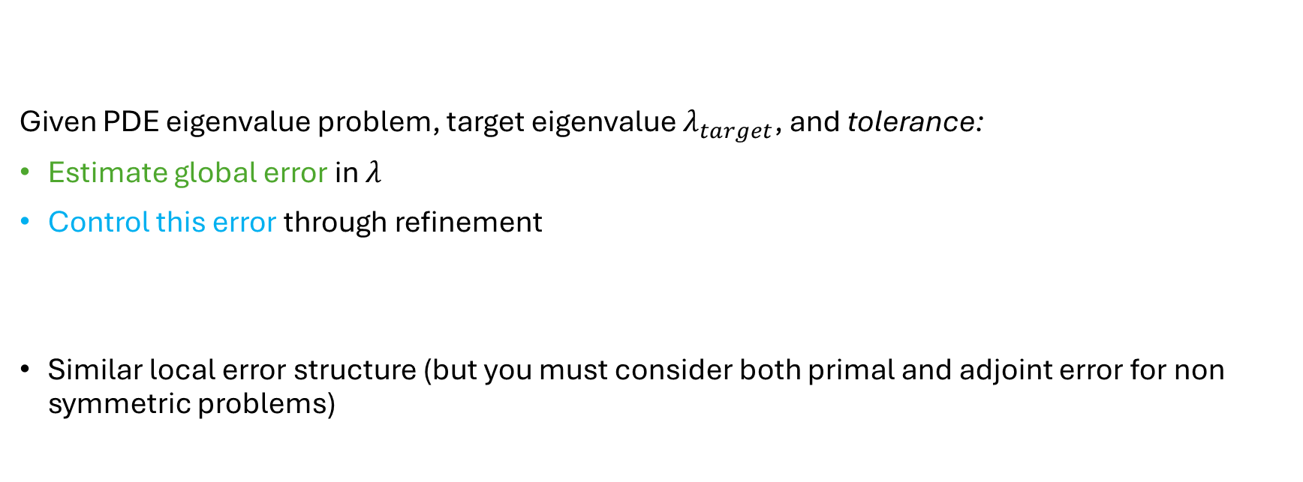
Extension: Eigenvalue problems
Find $\{u,λ\}$ such that:
$a\left(u,v\right)=λm(u,v)$, for all $v∈V$
Given PDE eigenvalue problem, target eigenvalue $λ_{target}$, and tolerance:
Estimate global error in $λ$
Control this error through refinement
Similar local error structure (but you must consider both primal and adjoint error for non symmetric problems)

Slide 15
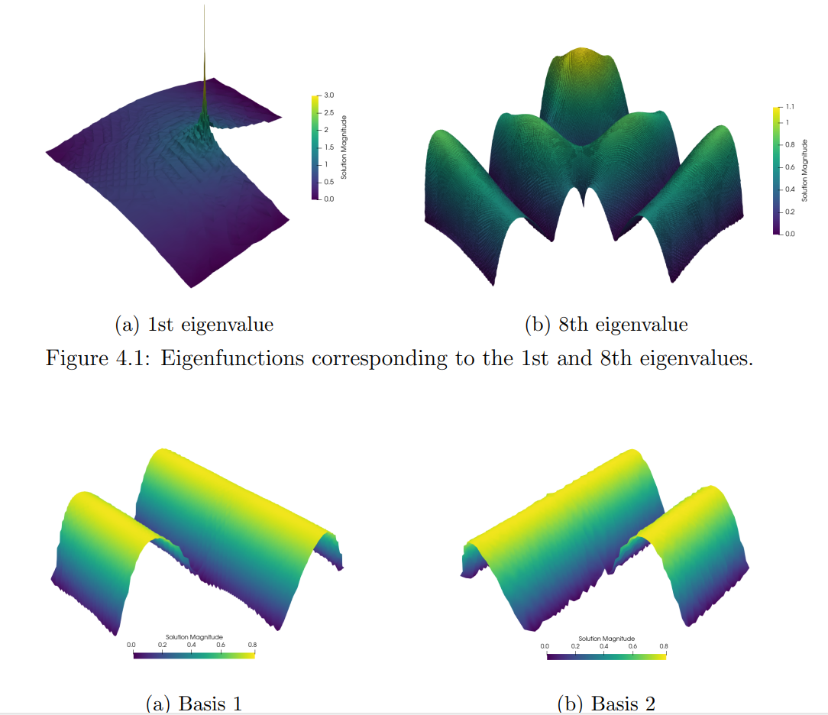
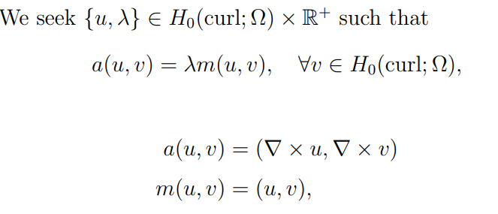
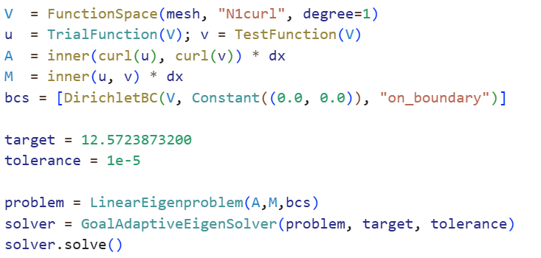
Example: Maxwell eigenvalue problem
Problem:
User input:

Slide 16
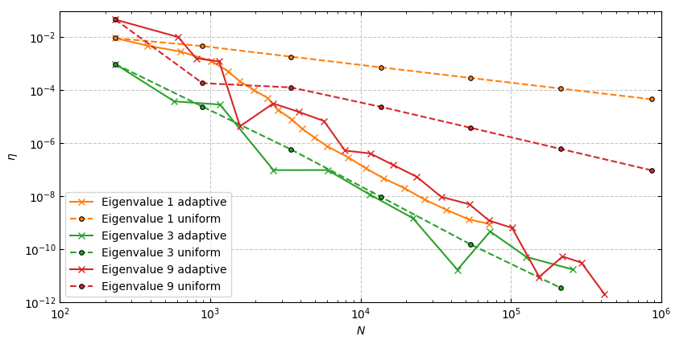
Example: Maxwell eigenvalue problem
Error
Number of degrees of freedom

Slide 17
Questions?

Slide 18






Example: Poisson equation
$$−∇^{2}u=f$$
$\int_{Ω}{−{(∇}^{2}u)v dx= \int_{Ω}{fv dx}}$
For all $v$ in $V$
$\int_{Ω}{∇u∙∇v dx= \int_{Ω}{fv dx}−}\int_{Γ}{∇u v dx}$
For all $v$ in $V$
$$a\left(u,v\right)=F(v)$$
For all $v$ in $V$

